Slide 1
BIA 650 Optimization and Process Analytics
11 – Process Modeling & Simulation
Simulation: The Nature of Models
Validating a Simulation Model
Demonstration
© E. A. Stohr, 2017
Notes:
Up to this point, we have been concerned with choosing & designing business processes.
In this lecture, we look at:
Simulation: How to check alternative process designs
WFMS: How to automate processes
Since not all processes can be expressed as fixed workflows, we also look at:
Groupware: How to support coordination in unstructured situations
Finally, we look at 2 real case studies involving the implementation of a WFMS

Slide 2
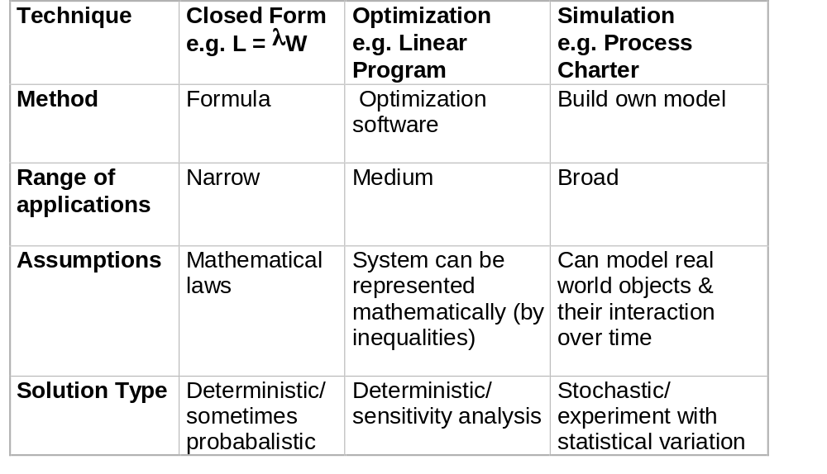
Types of Model

Slide 3
Simulation Concept
Inputs
Inputs
Real World
System
Simulated
System
Random
Events
Decision/
Policy
Random
Events
Decision/
Policy
Outputs
Outputs

Slide 4
Simulation Experiments
Because of random elements, one needs to run the simulation multiple times with a given policy setting (e.g. Process design) and obtain the mean and standard deviation of the results. In process simulation, always start by simulating the current (AS-IS) process If you obtain results for the AS-IS model that closely replicate the real world data, you can be more confident of your TO-BE model. Suppose the total time in the system is the most important design goal; run each model N times, for example:
AS-IS TO-BE
Run 1: W_{as-is, 1} = 111.2 W_{to-be, 1} = 101.7
Run 2: W_{as-is, 2} = 104.6 W_{to-be, 2} = 105.3
Run 3: W_{as-is, 3} = 121.2 W_{to-be, 3} = 102.4
Etc. Etc.
Run N: W_{as-is, N} = 115.2 W_{to-be, N} = 102.7
Mean _{as-is =} 112.2 Mean _{to-be} = 103.3
St.Dev _{as-is} = 5.7 Std.Dev _{to-be} = 4.6
Then run a hypothesis test to find out how statistically confident you are that the To-Be design is better than the existing As-Is design.

Slide 5
Simulation - Typical Use
1. Model the interrelationships in the real world and code into a computer program. Model the decisions or policies that can be controlled by management.
2. For a given structure or policy setting, run the model repeatedly through time, using random values for the parameters. This produces a random distribution of outputs for the model.
3. Change the structure or policy and repeat step 2.
4. After performing steps 2 and 3 multiple times one can compare the outputs from each setting of the structure/policy parameters and choose the optimal structure/policy

Slide 6
Monte Carlo Simulation
Howard has a foolproof method for winning at Las Vegas (a true story)
We will use a simulation program to test the effectiveness of Howard’s betting strategy.
The game involves repeated tosses of a fair coin. The gambler starts with $K capital and always bets “Heads”. The strategy is to bet one dollar at the start of the game and also if the result of the previous bet was a win. If the previous result was “Tails” (loss) Howard’s next bet is twice the value of the previous bet plus one dollar. The rules of the game forbid the bet being greater than a “House Limit of $H. The game halts after N1 tosses of the coin or if Howard’s capital, K, is zero or negative as a result of the previous toss.
The tossing of the coin is simulated by generating a random number in the range 0 to .99999 … If the generated “random number” is less than or equal to .5, the result of the toss is taken to be “Heads” otherwise, the result is tails. The simulation prints the results of each step for the first N2 < N1 iterations. To start the game, the user enters values for K, H, N1, N2, and S, where S is the random number “seed”. These values are printed at the end of the game.

Slide 7
Output from One Experiment
Initial Random Number is : 0.43952103203310866
Print header
capital = 1000 houselimit = 2000 randomNumSeed = 10 trialsDisplayed = 10 trialsTotal= 100
RandomNum = 0.43952103203310866
Value of i = 0 capital = 1000 bet = 1 result = HEADS
RandomNum = 0.6782559551338869
Value of i = 1 capital = 1001 bet = 1 result = TAILS
RandomNum = 0.27006794560012515
Value of i = 2 capital = 1000 bet = 3 result = HEADS
RandomNum = 0.9610559742709108
Value of i = 3 capital = 1003 bet = 1 result = TAILS
RandomNum = 0.5351152519223612
Value of i = 4 capital = 1002 bet = 3 result = TAILS
RandomNum = 0.8346592438133896
Value of i = 5 capital = 999 bet = 7 result = TAILS
RandomNum = 0.46286813399299875
Value of i = 6 capital = 992 bet = 15 result = HEADS
RandomNum = 0.357367663724389
Value of i = 7 capital = 1007 bet = 1 result = HEADS
RandomNum = 0.7937828531492978
Value of i = 8 capital = 1008 bet = 1 result = TAILS
RandomNum = 0.8822187429854581
Value of i = 9 capital = 1007 bet = 3 result = TAILS
RandomNum = 0.4929703375871034
Value of i = 10 capital = 1004 bet = 7 result = HEADS
Print result: 1100

Slide 8
Program Howard
Start
K = Capital
H = House Limit
S =Random Number Seed
N1 = No. of Trials Displayed
N2 = No. of Trials (Total)
B = Bet
Read
K, H, S
N1., N2
T=Initial random number
S=1
I=0
Print
Heading
Main Loop
A
I=I+1
I > N2
I
Print
Results
Stop
T=Random No.
T > 0.5
T < 0.5
T
Res=Heads
Res=Tails
I
I < N2
Print
I, K, B, Res
B

Slide 9
Program Howard (ctd.)
Tails
> 0.5
B
Heads
< 0.5
T
K= K - B
K= K+B
B= 1
K < 0
K
Main Loop
A
K > 0
Print
Results
B= 1 + 2*B
Stop
B > K
B
B= K
B < K
B > H
B
B= H
B < H
Main Loop
A

Slide 10
Pseudo Random Numbers (an Aside)
Making a deterministic computer generate random numbers.
r_{n+1} = (A × r_{n} + B) mod M
A, B and M are suitably chosen large numbers.
The “seed”, r₀, can be chosen optionally. This can be useful for variance reduction in simulation experiments. If you run the same system twice with different policy choices, you can set r₀ to the same number in each experiment. In affect, this means that each policy is tested against the same random number stream.
All computer languages have a function (say) rnd() that returns a random number in the range (0,1), thereby generating a uniform probability distribution:
Prob
1
1

Slide 11
BPR Modeling Tools
A model is a representation of reality that can be manipulated to provide information for decision making.
A good model is:
Capable of representing important features of the real world
  Usability, Understandability
  Gives correct answers!
  Facilitates sensitivity analysis
  Manages scenarios - records results from different runs

Slide 12
Uses of BPR Modeling Tools
Easy to Develop Documentation
Communicate with Users
Simulate Alternative Process Designs
(Provide estimates of cycle times, costs, queue sizes, etc.
under different design assumptions.)
Generate the Run-time System
Some workflow visual front-end tools do this.
IDS Scheer’s “ARIS” tool is tightly integrated with both SAP
and Staffware (a Workflow Management System)
Sample BPR Tools:
Simul8

Slide 13
Demonstration of SIMUL8

Slide 14
Validating a Modeling Tool
1. Perform Some Case Analyses
The best way to prove that a simulation modeling tool is correct is to use it to model some known situations and see if it can reproduce known results.
Example - to test the SIMUL8 Package, a case study was performed of a single server exponential queuing model (see next slide).
The results were consistent with the values given by the theoretical formulae for the single server exponential queue. (There was a slight difference due to randomness.)
2. Micro Analysis of the Operation of the Model
Step model through a discrete event process to make sure that each action by the model is performed as expected.

Slide 15
Single Server Queue Model
Arrivals
Queue
Server
Departures
Mu / unit time
Lambda / unit time
Lq
L
Single server queue with exponential interarrival & service times:
1/Lambda = mean time between arrivals; 1/Mu = S= mean service time
then:
Rho = Utilization = proportion of time server busy = Lambda/Mu
W = mean total time spent in the system = 1/(Mu-Lambda) = S/(1-Rho)
W_{q} = mean waiting time in queue = W - 1/Mu = Rho x W = S.Rho/(1-Rho)
L = mean number of people in the system = Lambda x W = Rho/(1-Rho)
Lq = mean number of people in the queue = Lambda x W_{q} = Rho x L
= Rho²/(1-Rho)

Slide 16
Validating Simul8
SIMUL8 Initial Testing |  |  |  | Theory
Model | Interarrival Distribution | Service Distribution | Lambda | S | Mu | Rho | Wq | W
1 | Expon(10) | Expon(0) | 0.10 | 0 | 0.00 | 0.0% | 0.00 | 0.00
2 | Expon(10) | Expon(2.5) | 0.10 | 2.5 | 0.40 | 25.0% | 0.83 | 3.33
3 | Expon(10) | Expon(5) | 0.10 | 5 | 0.20 | 50.0% | 5.00 | 10.00
4 | Expon(10) | Expon(7.5) | 0.10 | 7.5 | 0.13 | 75.0% | 22.50 | 30.00
5 | Expon(10) | Expon(10) | 0.10 | 10 | 0.10 | 100.0% | #DIV/0! | #DIV/0!
 |  |  |  | Simulation Estimates
Experiment | Interarrival Distribution | Service Distribution | Lambda | S | Mu | Rho | Wq | W | N
1 | Expon(10) | Expon(0) | 0.10 |  |  | 0.0% | 0 | 2.1 | 942
2 | Expon(10) | Expon(2.5) | 0.10 |  |  | 24.0% | 0.89 | 5.5 | 942
3 | Expon(10) | Expon(5) | 0.10 |  |  | 50.0% | 5.31 | 12.5 | 942
4 | Expon(10) | Expon(7.5) | 0.10 |  |  | 74.0% | 24.9 | 34.6 | 942
5 | Expon(10) | Expon(10) | 0.10 |  |  | 95.0% | 139.2 | 151.1 | 942

Slide 17
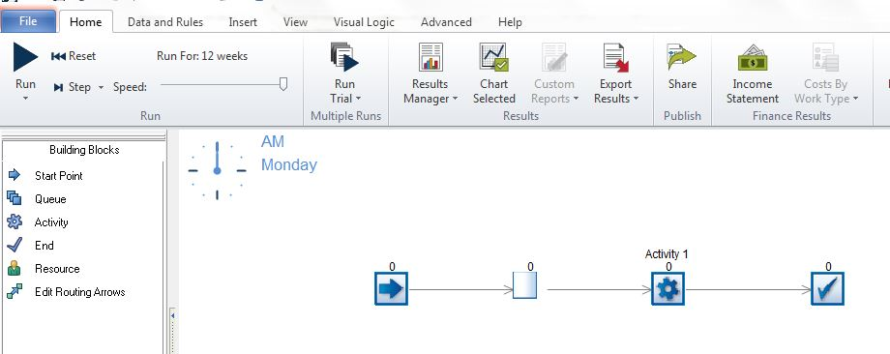
Simul8 Home Page
Model for single server queue experiment
Drag and drop icons; use “Snap to Grid” under View to align
Click here to see the history of run results expressed in the form of KPIs,
Right-click clock to set clock properties (next slide)
A trial consists of multiple runs.
Set number of runs and random number seed here.
Set travel time to zero here
Click Run to run Model for 12 weeks
Right-click blocks to set their properties;
Click Properties/Results to see results

Slide 18
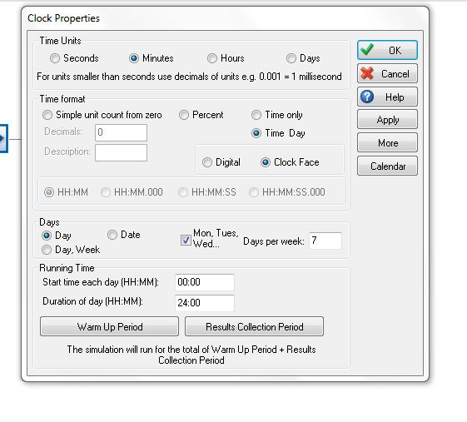
Set Clock Time
Clock setting to run 24 hours per day 7 days per week, time in minutes

Slide 19
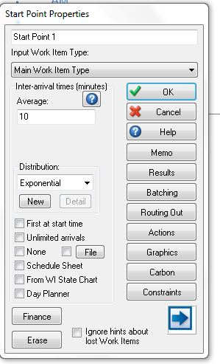
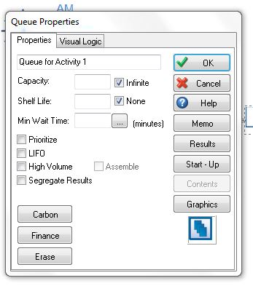
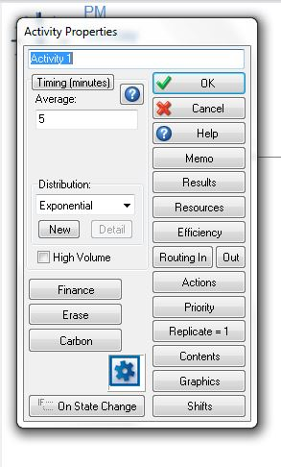
Set Parameters for each block
Exponential Inter-arrival times; mean = 10 mins
Queue should have infinite capacity for this experiment
Service times are exponential; mean = 5 mins

Slide 20
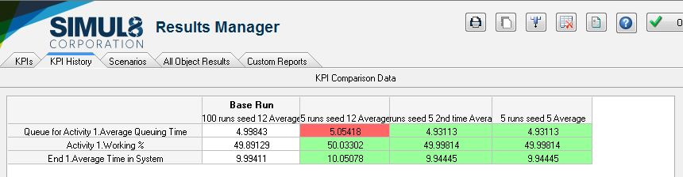
Random Number Seed & Results
Simul8 can also estimate the number of runs to achieve certain levels of accuracy (confidence intervals)
These KPIs were specified by right-clicking the actual result in the block’s Property/Results screen
Setting trail with large number of runs gives more accurate result
Same set-up different seed gives different result
Using the same set-up and the same random number seed gives same results as Initial trial.
Initial trial.

Slide 21
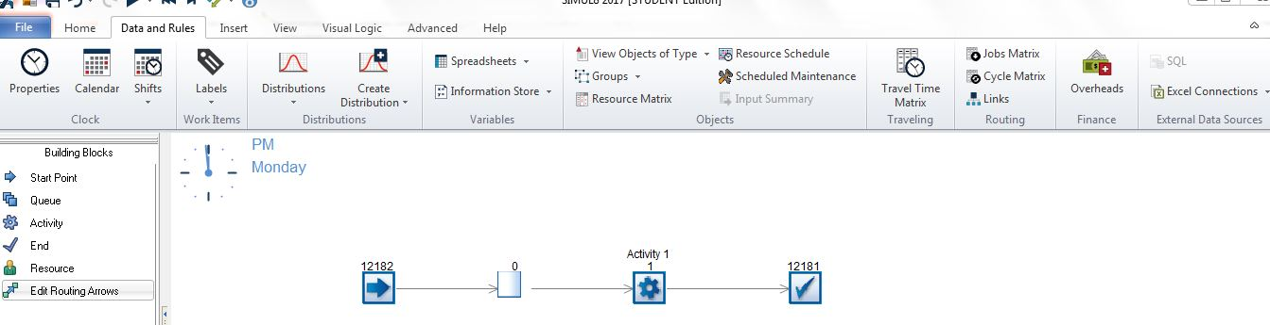
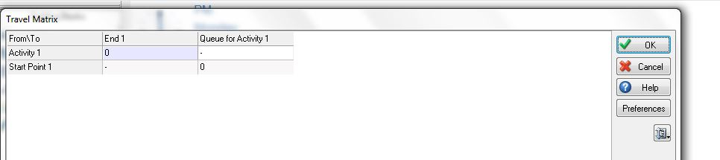
Set Travel Time to Zero (for this experiment)

Slide 22
Single Server Queue Properties
The number of people in the queue(Lq) and the number of people in the
system (L) depend only on the utilization (Rho)
The average time in the queue (Wq) or system (W) are both proportional to
the service time, S
The queue size is dependent on the variability of the service time
Queue size grows extremely rapidly for utilization ratios above 0.7 - 0.8
Mean
Queue Size, Lq
Exponential Service Time
Constant Service Time
Utilization,
Rho
0.50
0.75
1.0

Slide 23
Workflow Analysis Insights
Note: Lambda = 24 cases per hour (exponentially distributed)
Case 1: Fixed Resources
2 Resources
2 Resources
Arrival rate, Lambda = 24 cases per hour (exponentially distributed)
Task 1
Task 2
Service Time = 4 minutes /resource/task (exponentially distributed)
Service Time = 4 minutes /resource/task (exponentially distributed)
Service Rate, Mu = 30 cases per hour on both task 1 and task 2
Utilization, Rho = 24/30 = .80
Average queue time, Wq = Rho/(Mu - Lambda) = .8/(30-24) hours or 8 minutes
Average time to process a transaction = 8 + 4 + 8 + 4 = 24 minutes
Average length of queue Lq = Lambda x Wq = 30/60 x 8 = 4 transactions
(in front of each workstation)

Slide 24
Workflow Analysis Insights
Case 2: Flexible Resources
4 cross-trained and shared resources
Arrival rate, Lambda = 24 cases per hour (exponentially distributed)
Task 1
Task 2
Service Time = 4 minutes /resource/task (exponentially distributed)
Service Time = 4 minutes /resource/task (exponentially distributed)
Using Simulation:
Average time to process a transaction = 14 minutes (approx)

Slide 25
Workflow Analysis Insights
Case 3: Performing Task 1 in parallel
1 Resource
Task 1
2 Resources
Service Time = 4 minutes
Task 2
1 Resource
Service Time = 4 minutes
Task 1
Service Time = 4 minutes
Utilization = 0.80 as before
Using Simulation:
Average time to process a transaction = 15 minutes (approx)

Slide 26
Workflow Analysis Insights
Case 4: Triage on Task 1
1 Resource
Hard Cases
(25%)
2 Resources
Task 1
Service Time = 8 minutes
Easy Cases
(75%)
Task 2
1 Resource
Service Time = 4 minutes
Task 1
Service Time = 2 minutes
Utilization = 0.80 as before
Depending on the assumptions, Triage may or may not be better than the alternative (not simulated)

Slide 27
Workflow Analysis Insights
Case 5: Case Work
4 Resources
Arrival rate, Lambda = 24 cases per hour (exponentially distributed)
Task 1 and 2
Service Time = 7 minutes /resource/task (exponentially distributed)
Assumption!
Service Rate, Mu = 4 x 60/7 = 34.3 cases per hour
Utilization, Rho = 24/34.3 = .70
Average queue time, Wq = Rho/(Mu - Lambda) = .7/(34.3-24) hours or 4.1 minutes
Average time to process a transaction = 4.1 + 7 = 11.1 minutes
Average length of queue Lq = Lambda x Wq = 24/4.1 = 5.85 transactions
(in front of the workstation)

